Slide 1

Project Title -Seasonal Agriculture Performance Analysis
Student Name-Narayana Meghana
College Name-Loyola Academy
AICTE STU ID :STU6a057be19014c1778744289

Slide 2

PROBLEM STATEMENT
Agricultural activities are influenced by seasonal variations in environmental conditions, farming practices, resource availability, and market conditions. As a result, agricultural performance may differ from one season to another. However, raw agricultural data does not clearly explain how agricultural performance changes across seasons or what patterns can be observed in different seasonal conditions. The problem is to analyze the given agricultural dataset and investigate seasonal differences in agricultural performance by identifying meaningful patterns, trends, relationships, and variations within the available data.

Slide 3
Project Description
This project analyzes agricultural data representing activities carried out across different seasons, geographical areas, and farming conditions. The dataset contains information on farming practices, environmental factors, crop production, resource usage, and economic performance. The primary objective is to clean and prepare the data to examine how performance varies across seasons, investigate relationships between seasonal conditions and agricultural outcomes, and identify unusual patterns. By applying appropriate statistical and visualization techniques, this project aims to develop data-driven recommendations and meaningful conclusions. The complete analysis is documented in a Jupyter Notebook.

Slide 4

WHO ARE THE END USERS?
Agricultural Stakeholders: To understand variations in agricultural performance and identify important seasonal trends.
Planners & Policymakers: To support evidence-based agricultural planning by comparing performance across different periods.
Farmers & Resource Managers: To examine differences in resource usage and understand changing environmental conditions across seasons.

Slide 5

Technology Used
Python: The core programming language used for data manipulation and analysis.
Jupyter Notebook: For documenting the complete analysis, code execution, and insights.
Pandas: For loading, cleaning, and preparing the seasonal agricultural data.
Matplotlib & Seaborn: For applying appropriate visualization techniques to identify patterns and trends.

Slide 6
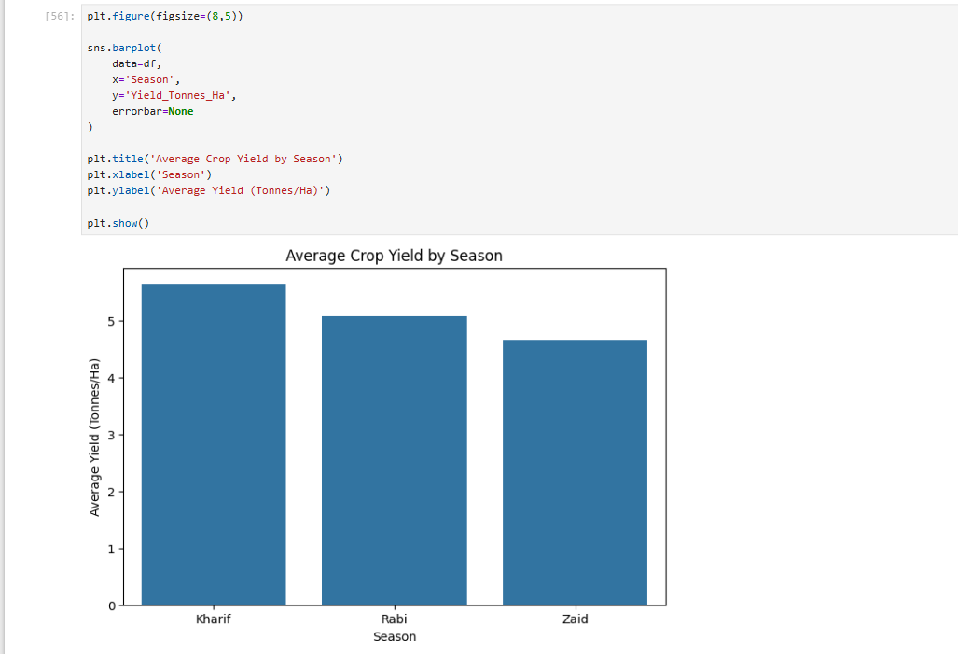
RESULTS
This bar chart compares the average yield (Tonnes/Ha) across the three major agricultural seasons — Kharif, Rabi, and Zaid. It shows that Kharif has the highest yield, followed by Rabi, while Zaid records the lowest.

Slide 7
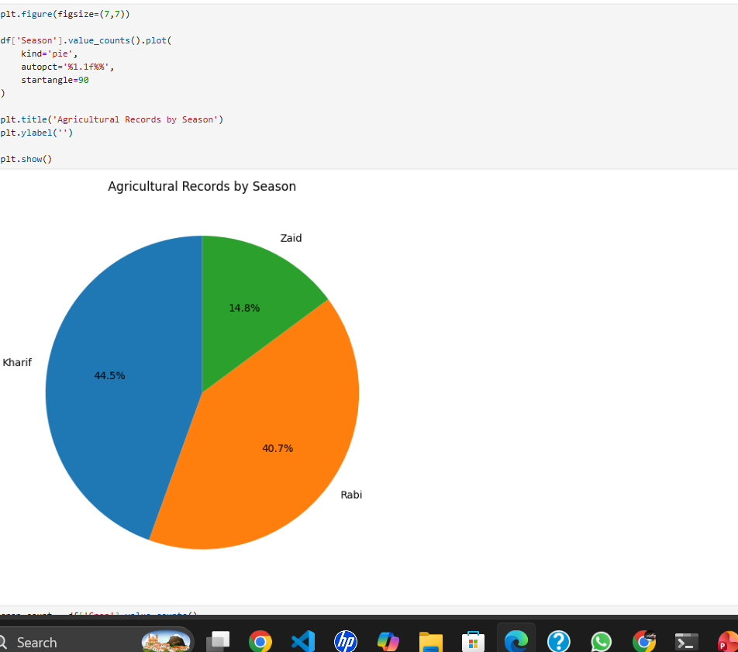
RESULTS
The pie chart displays the distribution of agricultural records among seasons. Kharif dominates with 44.5%, Rabi follows with 40.7%, and Zaid contributes 14.8%.

Slide 8
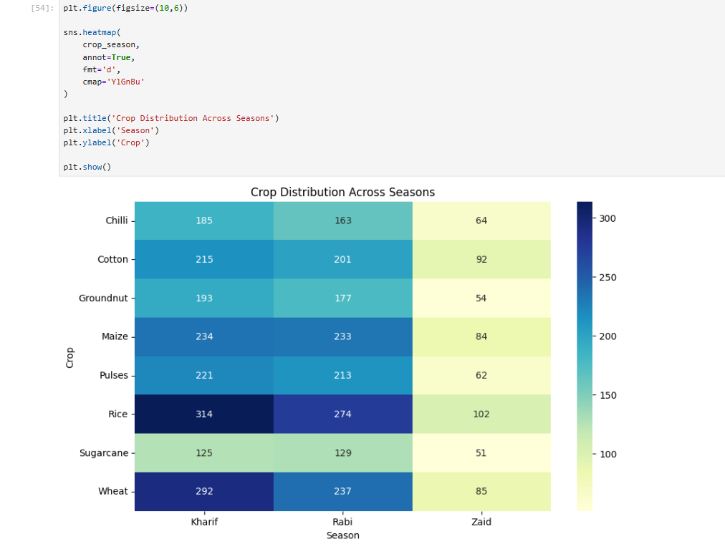
RESULTS
This heatmap visualizes how different crops are grown across Kharif, Rabi, and Zaid seasons. Darker shades indicate higher counts — crops like Rice and Wheat are widely cultivated, while Sugarcane and Groundnut have lower distributions.

Slide 9
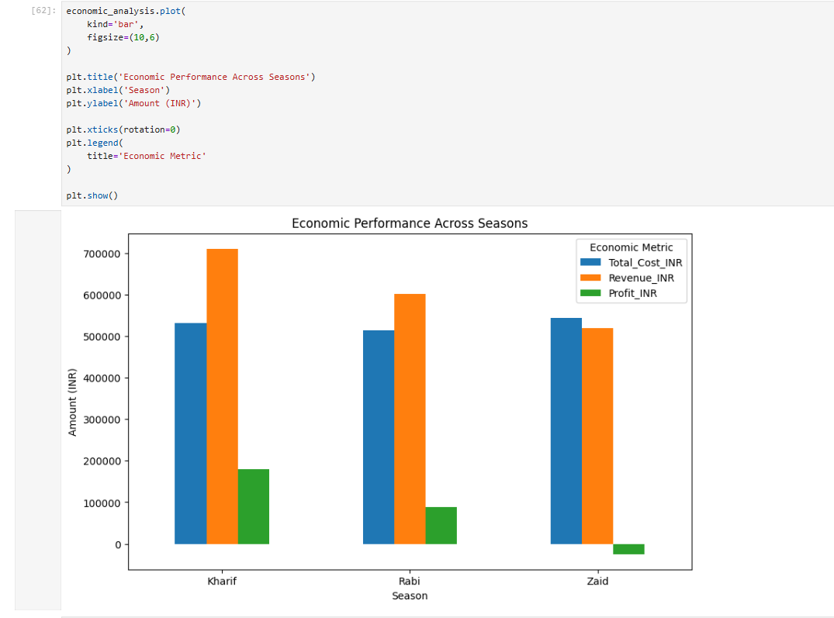
RESULTS
The grouped bar chart compares Total Cost, Revenue, and Profit (INR) for each season. Kharif yields the highest profit, Rabi moderate, and Zaid the lowest — possibly due to reduced yield or higher costs.

Slide 10
Future scope
Investigate whether these seasonal patterns are consistent across different specific regions and districts.
Analyze the direct relationships between seasonal environmental conditions (like rainfall and temperature) and agricultural performance.
Explore how to use these findings to support better seasonal agricultural planning and optimize resource usage across seasons.

Slide 11
GitHub Link
https://github.com/meghana1209-06/Seasonal-Agriculture-Performance-Analysis.git

Slide 12
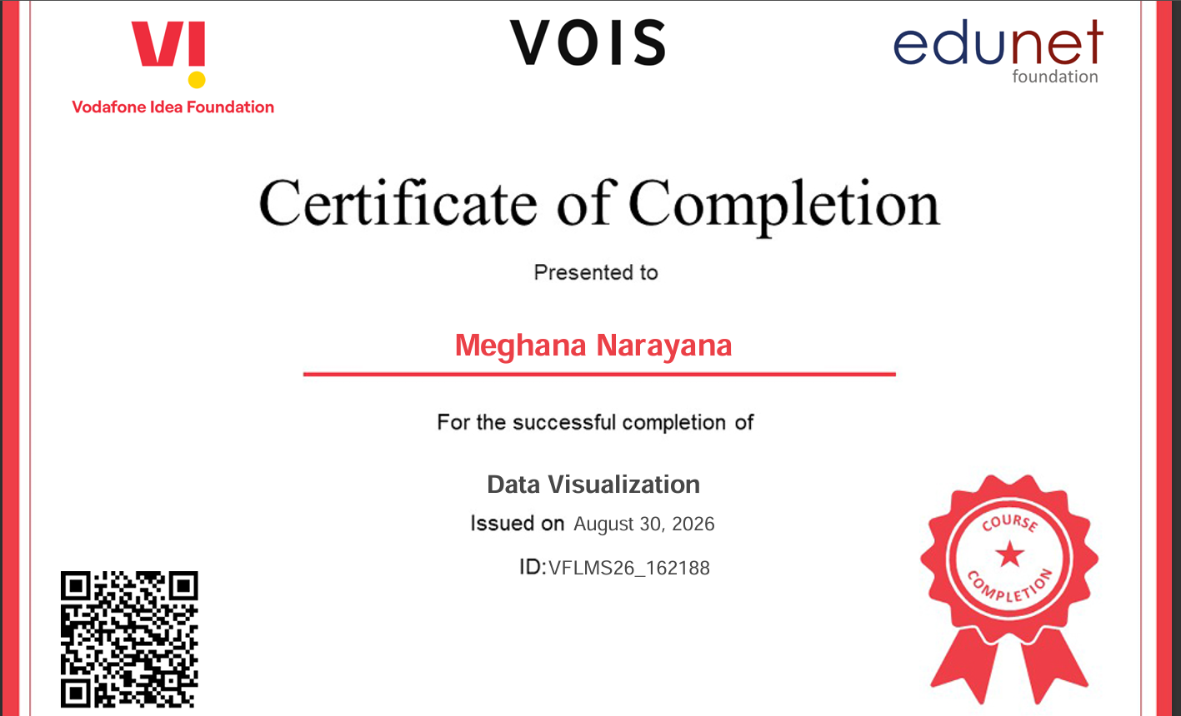
VOIS Course completion certificate -
Course name- Data Visualization

Slide 13
Thank you
.
.

